Slide 1
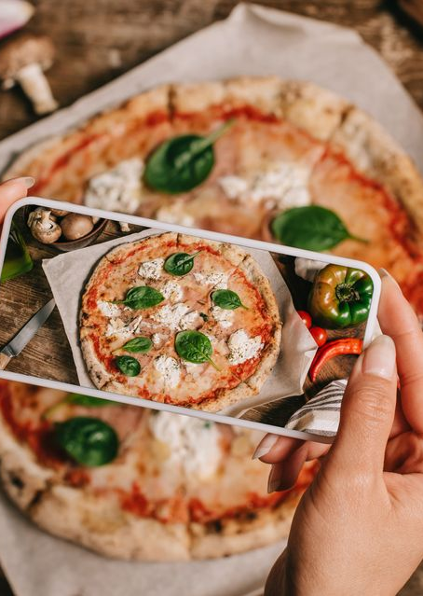
Exploring consumer insights: F&B MARKET ANALYSIS IN DHAKA

Slide 2
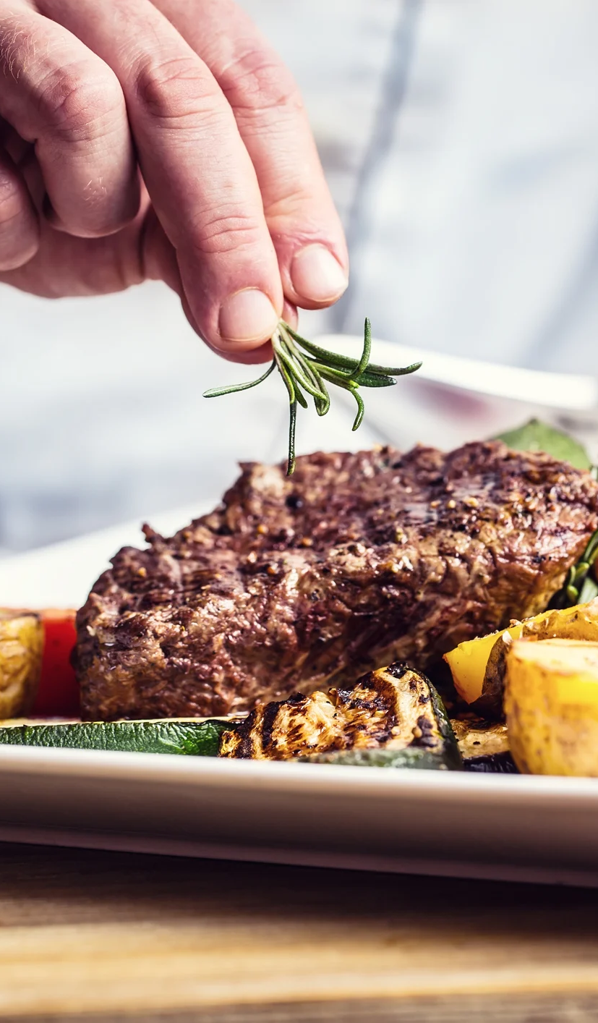
INTRODUCTION General & Problem Description
General Description:
The food and beverage (F&B) industry in Dhaka City is vibrant and dynamic.
Reflects the rich culinary diversity of the region.
Array of restaurants offering diverse cuisines.
Plays a crucial role in shaping the city's cultural and social landscape.
Analysis Focus:
Hustle and bustle of Dhaka's restaurant scene.
Evolving consumer preferences, market trends, and challenges faced by local establishments.
Market Evolution:
City's F&B market has witnessed an evolution post COVID 19
Propelled by globalization, urbanization, and the cosmopolitan nature of Dhaka's residents.
Surge in the number of restaurants, cafes, and eateries.
Transformation of Dhaka into a culinary destination.
Resilience Amid Challenges:
Despite economic fluctuations and external disruptions.
Dhaka's restaurant owners and chefs remain resilient.
Continuously adapting to the dynamic demands of the market.
Integral Part of City's Identity:
As Dhaka grows and diversifies, the F&B sector stands as an integral part of the city's identity.
Reflects the evolving landscape and capacity for innovation and adaptation towards foreign cuisines.

Slide 3
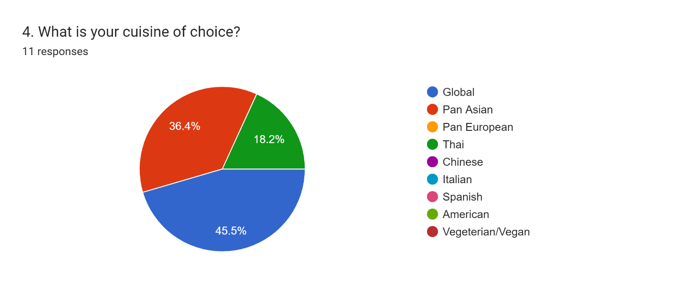
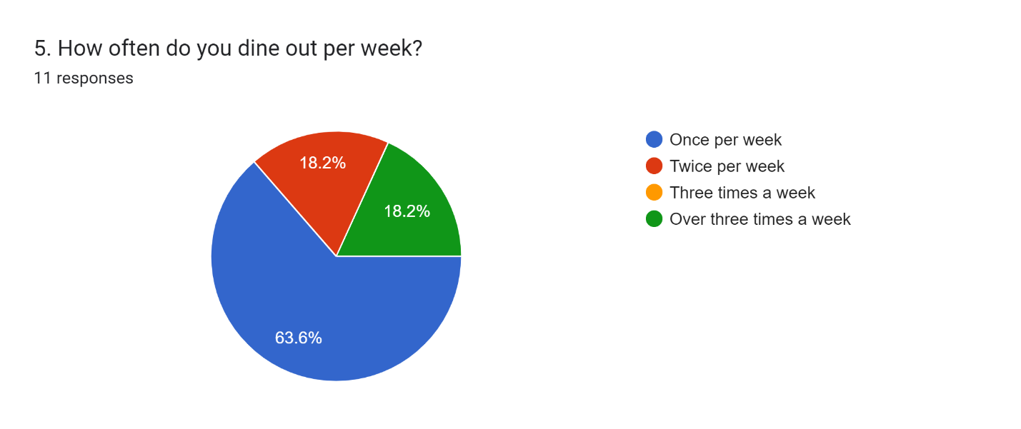
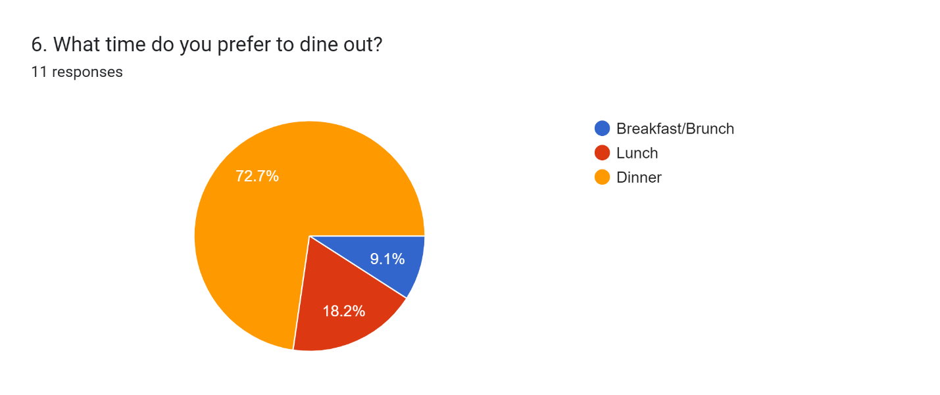
RESEARCH QUESTIONS & Data Presentation
Roughly 45% of the consumers surveyed expressed that they prefer a Global cuisine, followed by preferences for Pan-Asian cuisine.
63.6% of the consumers prefer to dine out once a week, while 18.2% prefer to dine our once-twice a week.
72.7% of the consumers prefer to dine out during dinner time.

Slide 4
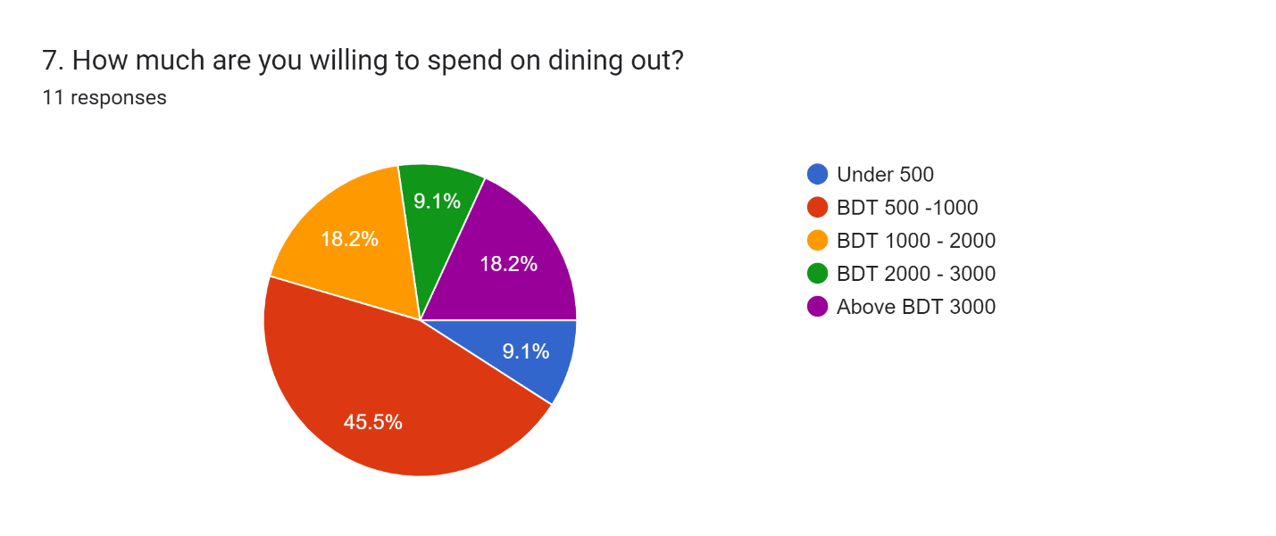
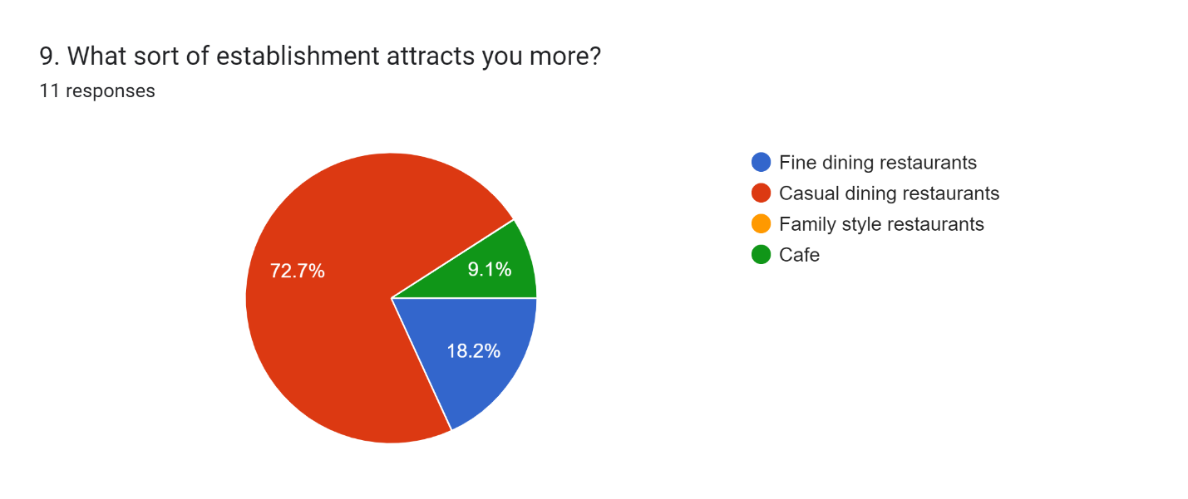
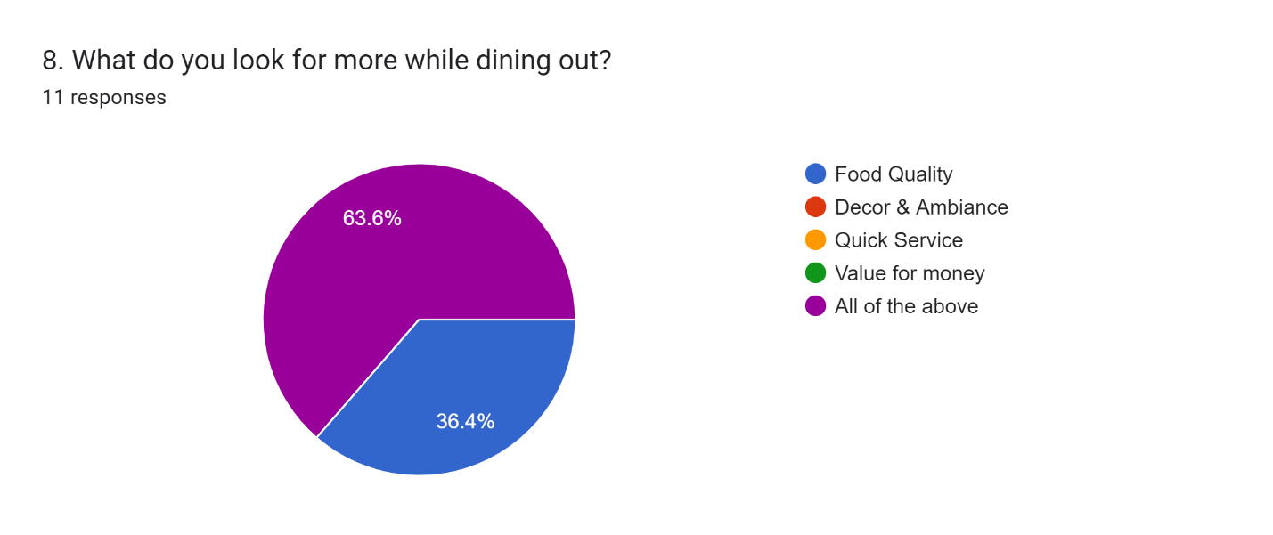
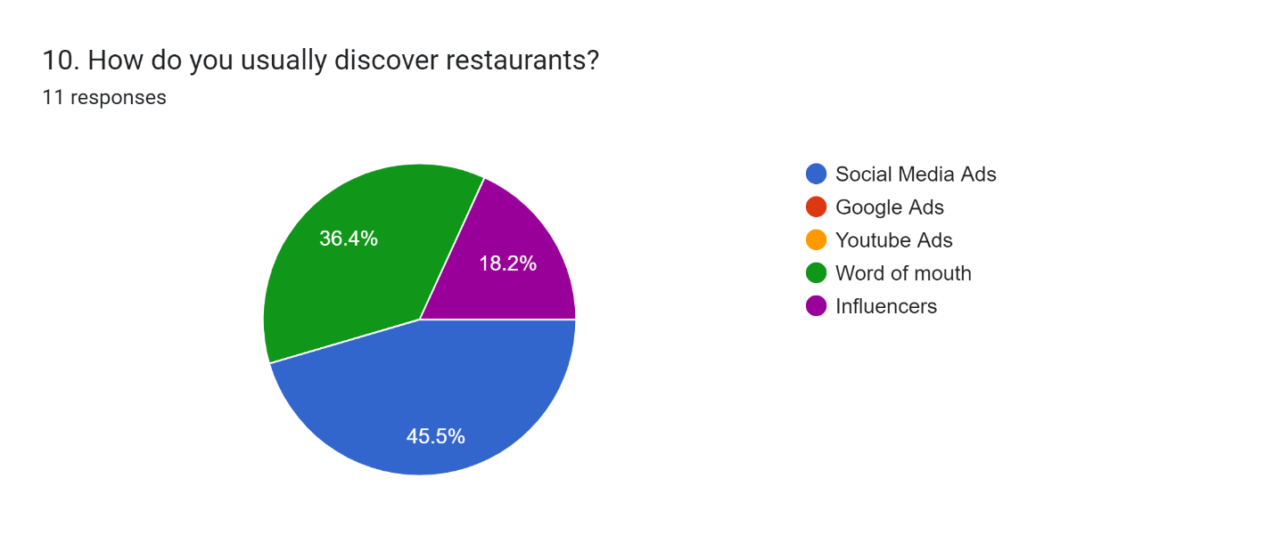
RESEARCH QUESTIONS & Data Presentation
The majority of consumers expressed that they prefer to spend between BDT 500 – 100 dining out, leaving with a small number of people who would actually be willing to spend over BDT 2000.
72.7% of the consumers preferred casual style restaurants.
63.6% consumers prefer a mix of Food Quality, Décor, Prompt Service & Value for Money while dining out.
Majority of consumers discover restaurants through social media ads, while 36.4% come across them from word of mouth.

Slide 5

RESEARCH METHOD
Mixed-Method Approach
Qualitative and Quantitative Research
Primary and Secondary Data Collection
Tools used:

Slide 6
LEARNINGS & CONCLUSIONS
Consumer Feedback Highlights:
Quality of Food: Common concern about the inconsistency in food quality over time.
Importance of Authenticity: Consumers value the authenticity of the dining experience.
Affinity and Disappointment: Patrons often face disappointment when their favorite establishments experience a decline in quality.
Recommendations Based on Consumer Feedback:
Operational Focus: Encourage restaurant owners to prioritize product development and operational excellence over rapid expansion or branding efforts.
Quality Assurance: Stress the importance of regular inspections and adherence to strict regulatory rules to maintain consistent food quality.
Customer-Centric Approach: Emphasize that a consumer-centric approach, focusing on the authenticity and uniqueness of the product, can drive long-term success.

Slide 7
LEARNINGS & CONCLUSIONS
Survey Findings:
Consumer Preferences:
45% prefer Global cuisine, while Pan-Asian cuisine also enjoys significant popularity.
63.6% of consumers dine out once a week, with 18.2% opting for once or twice a week.
Majority (unspecified percentage) prefer to spend between BDT 500 – 1000 when dining out.
Conclusion:
Key Insights:
Importance of Quality: Quality remains a pivotal factor influencing consumer choices.
Unique Dining Experiences: Consumers seek unique and immersive settings.
Online Reputation Matters: Online reviews and social media feedback significantly impact decision-making.
Health-Conscious Trends: A rising trend in health-conscious dining preferences observed.

Slide 8
Thankyou.

